Slide 1
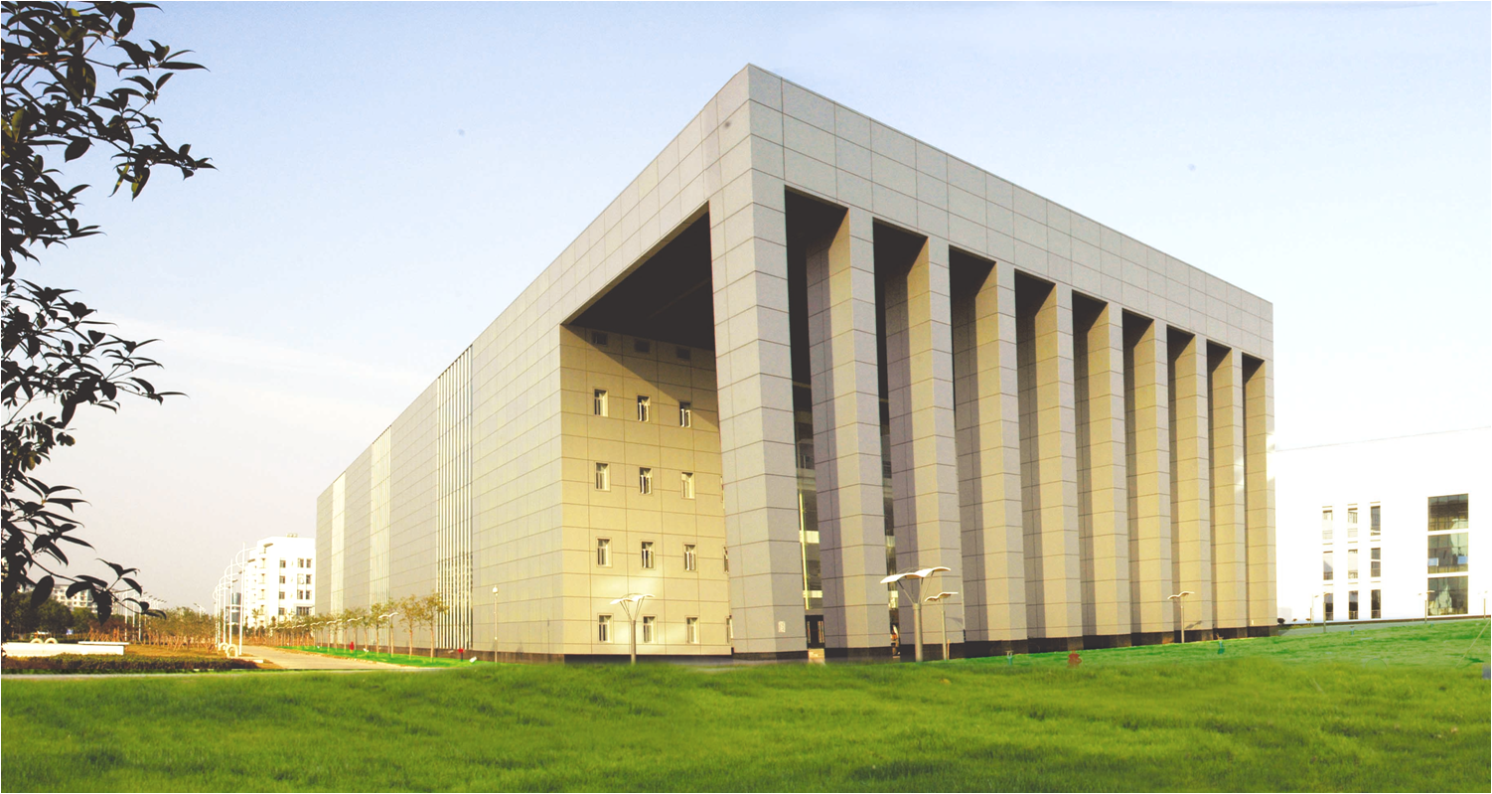
Hierarchical Meta-Learning with Hyper-Tasks for Few-Shot Learning
Yunchuan Guan
Notes:
Good morning, ladies and gentlemen my name is Yunchuan Guan. The title of my paper is Hierarchical Meta-Learning with Hyper-Tasks for Few-Shot Learning
.

Slide 2
Reminder
We extend the concept of meta-learning
The key idea of this paper is meta learn the meta-learning algorithms
The application of our framework involves few-shot learning and domain adaption
Notes:
The topic of this paper is meta-learning.
The core of this paper consists of the following three aspects.

Slide 3
Background(I.I.D Assumption)
…
Learning on samples
I.I.D Samples
Learning model
…
Learning on tasks
I.I.D Tasks
Meta learning model
Notes:
Let’s start with background.
Its well known that classical learning algorithm learn on samples, and meta-learning algorithms learning on tasks.
As shown in the blue part, the best performance of the classical learning model is usually guaranteed by the constraint of I.I.D samples, that is independent and identically distributed samples.
Similarly, in yellow part, the best performance of meta-learning model is guaranteed by I.I.D tasks.

Slide 4
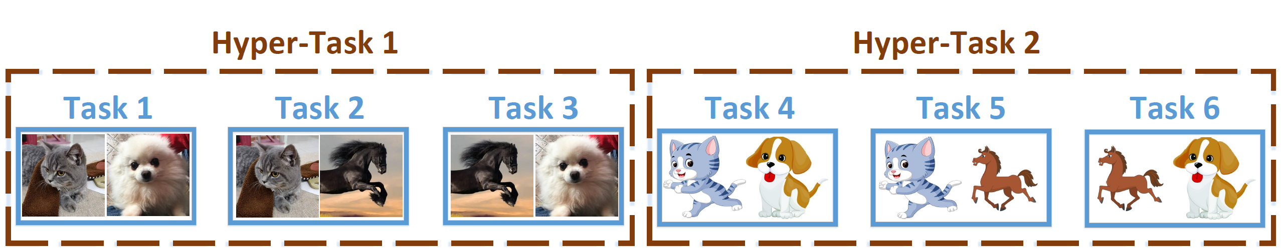
Background(Non I.I.D Tasks)
Tasks in the first brown box do not share the same distribution with those in the second brown box .
Notes:
However, in most cases, tasks are non-i.i.d.
As shown in this figure, there are six images from three species, that is cats, dogs and horses, and two styles, that is realistic and cartoon. We can use this image to construct task 1,2,3,4,5 6.
Apparently, tasks in the first brown box do not share the same distribution with those in the second brown box, cause they are in different styles.
Classical meta-learning algorithms learn all six tasks by a shared meta-learner while ignoring the relationship among task 1, 2,3 and the difference between tasks in different brown boxs.

Slide 5
Idea(Data distribution perspective)
Learning
Meta Learning
???
Sample level i.i.d
Sample level i.i.d
Sample level i.i.d
Task level i.i.d
Task level i.i.d
Task level i.i.d
??? = Meta-meta-learning
= Hierarchical meta-learning
Notes:
So, how to deal with this problem?
We can find patterns in data distribution.
As shown in the table, classical learning algorithm need sample-level I.I.D constraint. Since the samples are I.I.D, tasks constructed by these sample are also I.I.D.
Meta learning algorithm need task-level I.I.D constraint. The difference is that, task-level I.I.D can not deduce sample-level I.I.D. This means that meta-learning can release the sample-level I.I.D constraint.
Now, if we want to release task-level I.I.D constraint, what should we do?
Intuitively, we should wrap a layer of meta-learning algorithms on top of meta-learning algorithms. That is, meta-meta learning, that is hierarchical meta-learning.

Slide 6
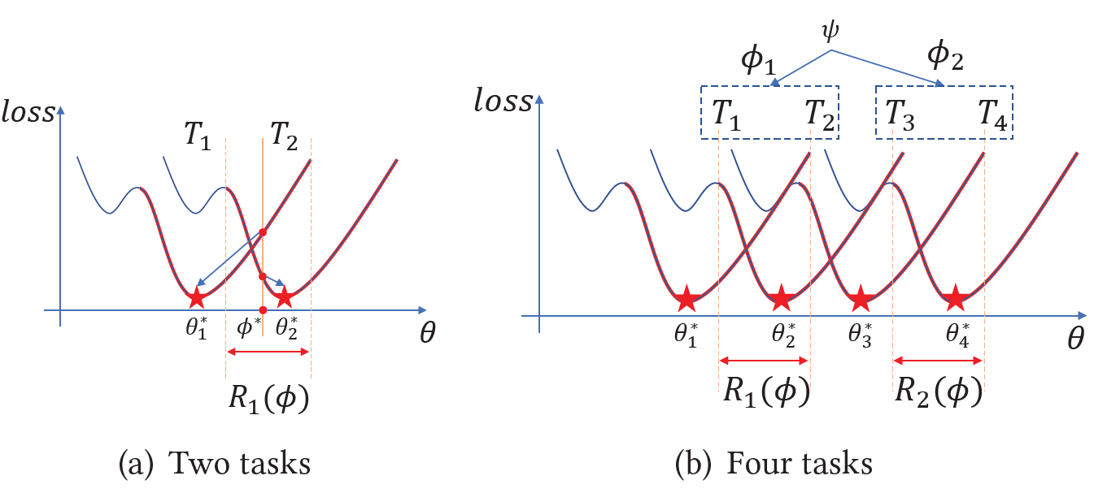


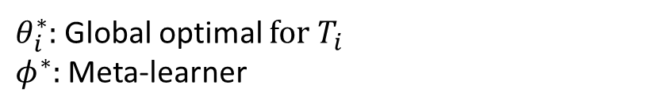
Idea(Landscape perspective)
$$R_{1}∩R_{2}=∅$$
$θ_{i}^{∗}$: Global optimal for $T_{i}$
$φ^{∗}:$ Meta-learner
${ R}_{1}\left(φ\right)$: Feasible region of MAML
Notes:
Further, let's look at this idea from the perspective of landscape.
The two curves in Figure (a) are the landscape for Task 1 and Task 2.
The pentagram labelled by $θ_{1}^{∗}$ and $θ_{2}^{∗}$ are the optimal parameters for the two tasks.
A meta-learning algorithm, for example MAML, will find a meta-learner $φ^{∗}$ in interval$R_{1}$. As indicated by the blue arrows, $φ^{∗}$ can reach each tasks’ optimal parameter after few steps of adaption.
However, when we add two more tasks $T_{3}$ and $T_{4}$, meta-learning may not work. This is because MAML‘s meta-learner on T3 and T4 belong to the interval $R_{2}$, when the intersection of interval R1 and R2 is an empty-set, MAML can not find a good initialization for all task 1,2,3,4.

Slide 7
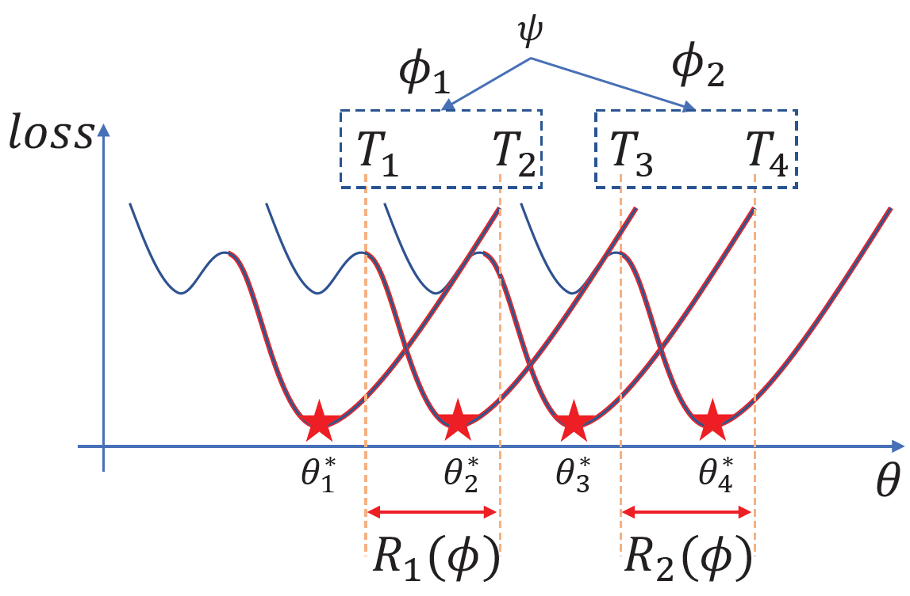
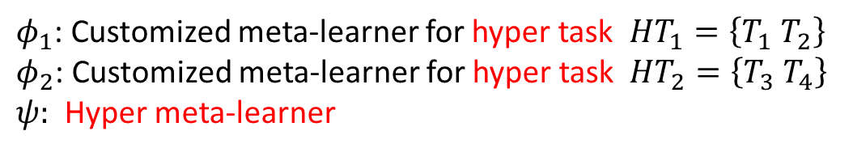
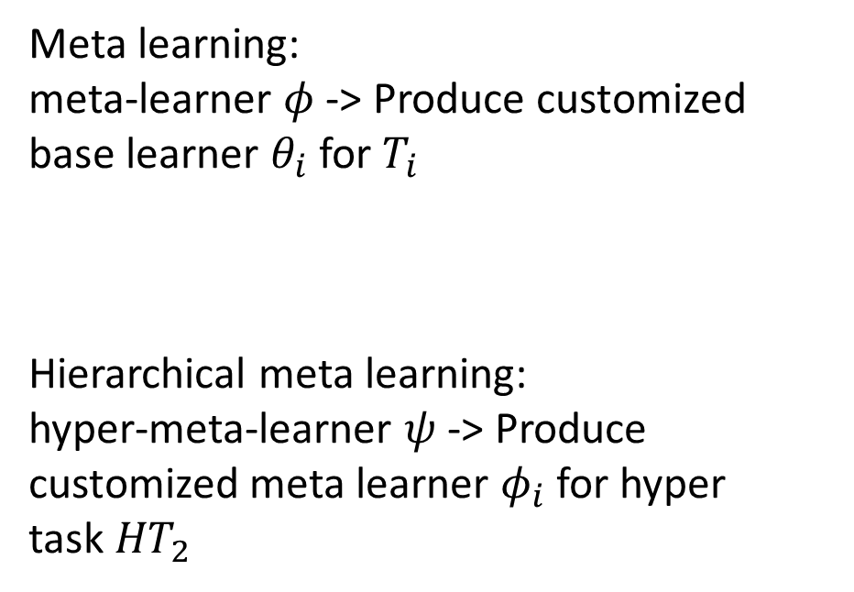
Idea(Landscape perspective)
Meta learning:
meta-learner $φ$ -> Produce customized base learner $θ_{i}$ for $T_{i}$
Hierarchical meta learning:
hyper-meta-learner $ψ$ -> Produce customized meta learner $φ_{i}$ for hyper task${HT}_{2}$
$φ_{1}$: Customized meta-learner for hyper task ${HT}_{1}=\left\{T_{1} T_{2}\right\}$
$φ_{2}$: Customized meta-learner for hyper task ${HT}_{2}=\left\{T_{3} T_{4}\right\}$
$ψ:$ Hyper meta-learner
Notes:
Inspiring by the idea of meta-learning.
We can further construct tasks to hyper-task, for example, we construct $T_{1}$ and $T_{2}$ to $HT_{1}$. We can also further learn a hyper-meta-learner $ψ$, which can produce customized meta-learner $φ_{1}$ for task 1,2 and $φ_{2}$ for task 3,4.
Let‘s organize our thoughts, The meta-learning algorithm learns a meta-learner, it produce customized base learner $θ_{i}$ for $T_{i}$.
Hierarchical meta-learning learns a hyper-meta-learner, it produce customized meta learner $φ_{i}$ for hyper task $HT_{i}$

Slide 8
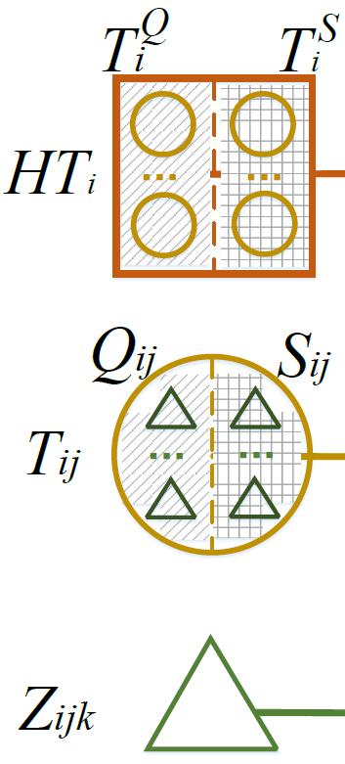
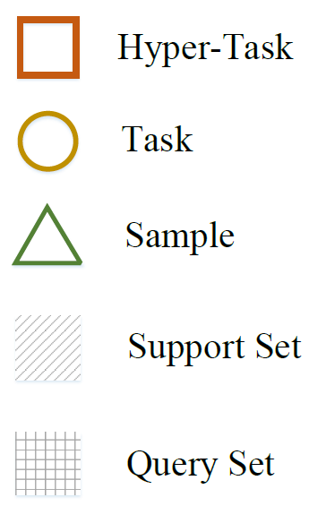
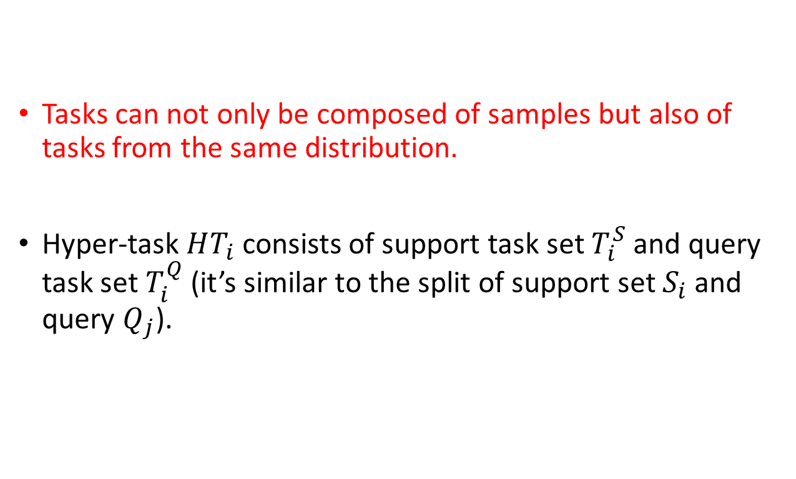
Method(Hyper task)
Tasks can not only be composed of samples but also of tasks from the same distribution.
Hyper-task $HT_{i}$ consists of support task set $T_{i}^{S}$ and query task set $T_{i}^{Q}$ (it’s similar to the split of support set $S_{i}$ and query $Q_{j}$).
Notes:
Now let’s talk about our method.
First, we expanded the concept of task. That is : tasks can not only be composed of samples but also of tasks from the same distribution.
As show in the left figure, square represents the hyper-task, circle represent the task and the triangle represent sample.
From the bottom to the top, multiple samples make up a task, and multiple tasks make up a hyper-task
In addition, a hyper-task $HT_{i}$ consists of a support task set $T_{i}^{S}$, and a query task set $T_{i}^{Q}$, which is similar to the split of support set $S_{i}$ and query set $Q_{j}$ in an ordinary task.

Slide 9
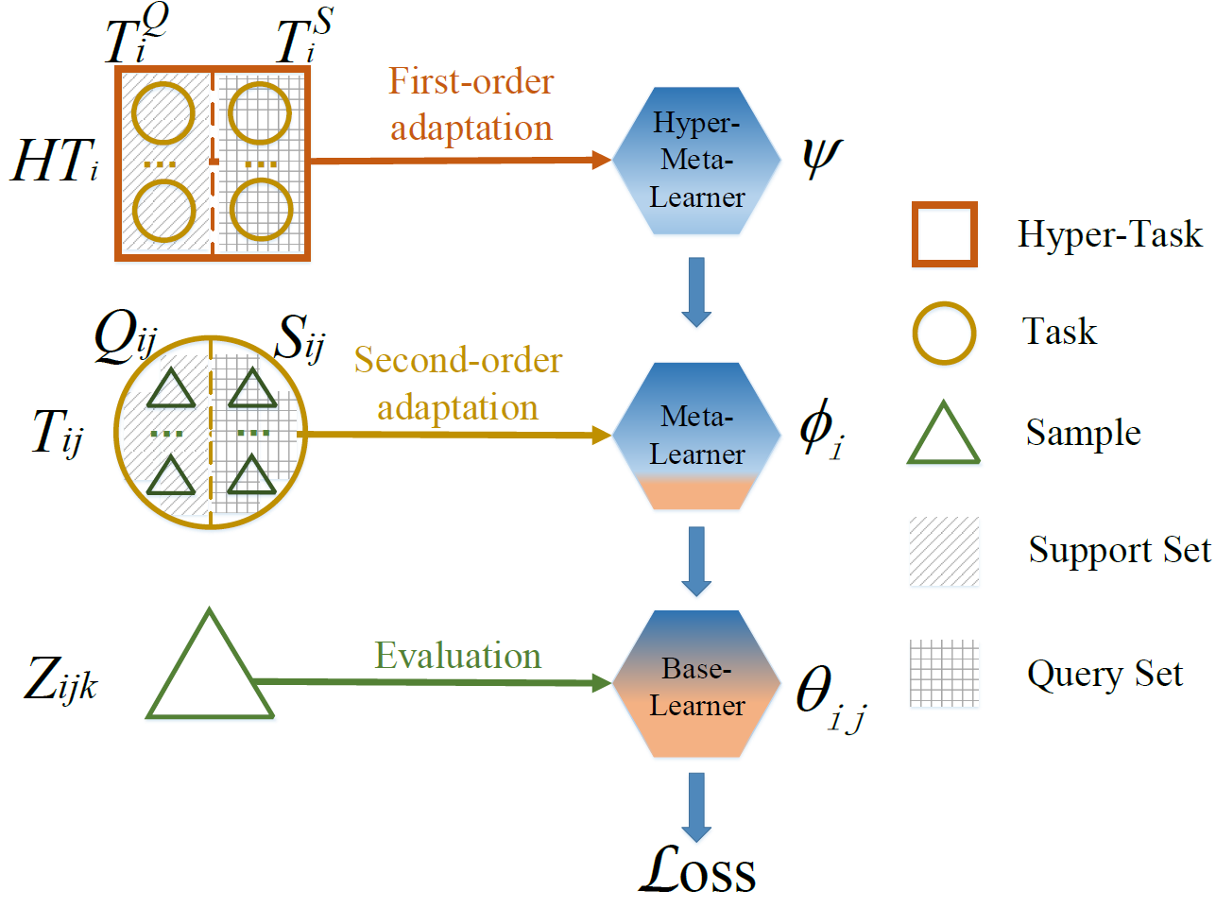
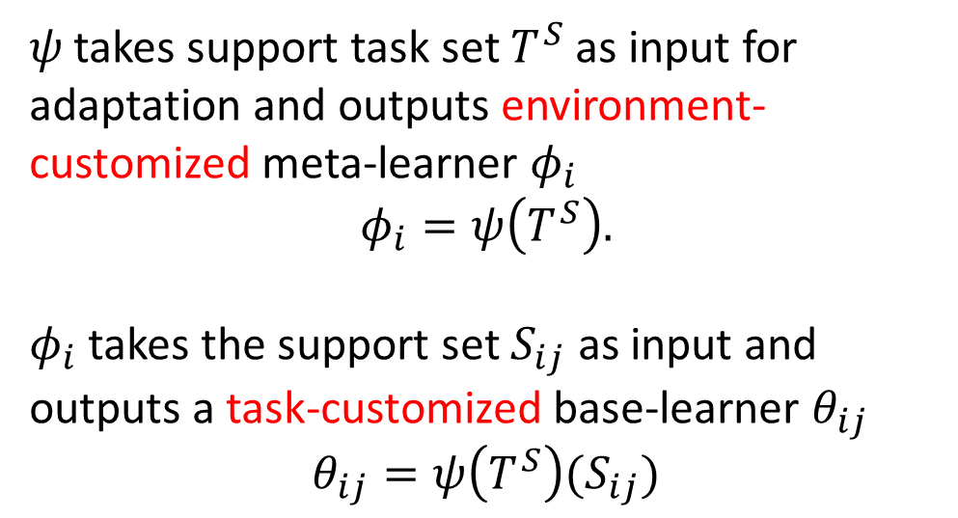
Method (Hierarchical meta-learning)
𝜓 takes support task set $T^{S}$ as input for adaptation and outputs environment-customized meta-learner $φ_{i}$
$$φ_{i}=ψ\left(T^{S}\right).$$
$φ_{i}$ takes the support set $S_{ij}$ as input and outputs a task-customized base-learner $θ_{ij}$
$$θ_{ij}=ψ\left(T^{S}\right)(S_{ij})$$
Notes:
Second, we leverage a hyper-meta-learner 𝜓. It’s an adaption function that takes $T^{S}$ as input for adaptation and outputs environment-customized meta-learner $φ_{i}$ , as shown in the following equation$.$
$φ_{i}$ is also an adaptation function that takes $S_{ij}$ as input and outputs a task-customized base-learner $θ_{ij}$, as shown in the following equation.
In fact, we can consider the process of obtaining $θ_{ij}$ as “a second-order adaptation process”. As shown in the left figure. $ψ$ use $T_{i}^{S}$ to perform first-order adaption and we will get an environment-customized meta-learner $φ_{i}$. Then, $φ_{i}$ use $S_{ij}$ to perform second-order adaption and we can get a task-customized base-learner $θ_{ij}$.
When the model is well trained, $θ_{ij}$ will get a smaller loss when evaluating on $z_{ijk}.$

Slide 10
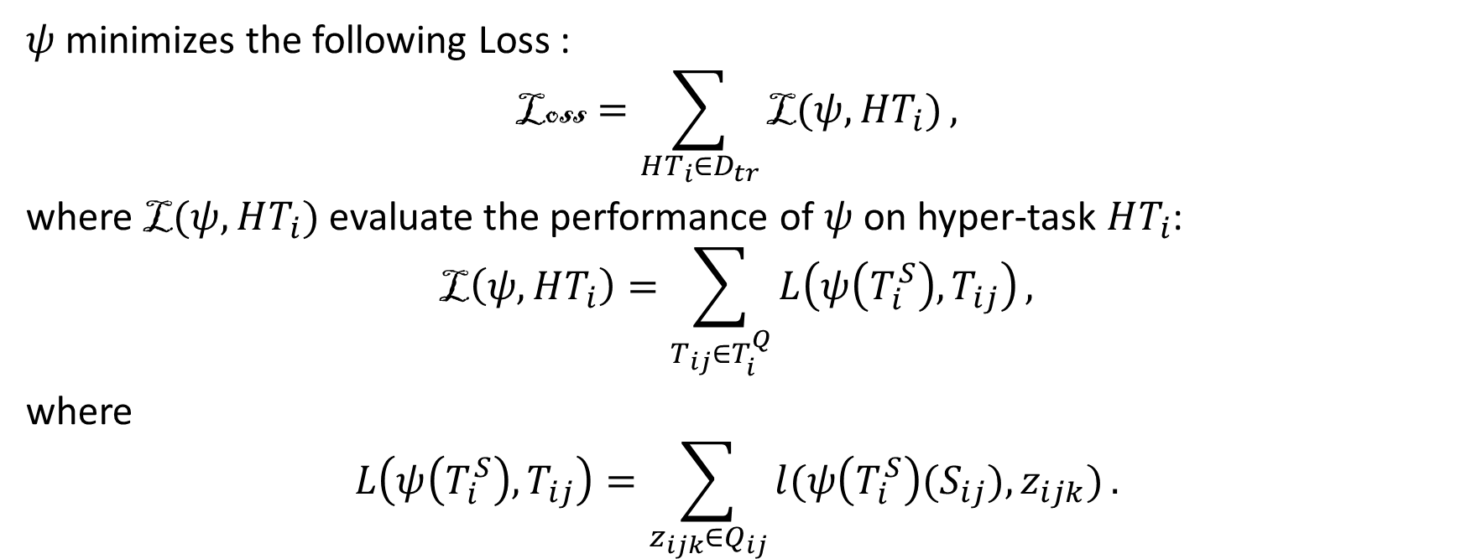
Method (Hierarchical meta-learning)
$ψ$ minimizes the following Loss :
$$\text{L}\text{oss}=\sum_{HT_{i}∈D_{tr}}{\text{L}(ψ,HT_{i})},$$
where L$(ψ,HT_{i})$ evaluate the performance of $ψ$ on hyper-task $HT_{i}$:
$$\text{L}\left(ψ,HT_{i}\right)=\sum_{T_{ij}∈T_{i}^{Q}}{L\left(ψ\left(T_{i}^{S}\right),T_{ij}\right)},$$
where
$$L\left(ψ\left(T_{i}^{S}\right),T_{ij}\right)=\sum_{z_{ijk}∈Q_{ij}}{l(ψ\left(T_{i}^{S}\right)(S_{ij}),z_{ijk})}.$$
Optimizing $\text{Loss}$ essentially optimizes a two-order adaptation process $ψ\left(T_{i}^{S}\right)\left(S_{ij}\right).$
Notes:
Here is loss we need to optimize during training phase. Ignoring the process, let's just focus on this statement:
That is “Optimizing $\text{Loss}$ essentially optimizes a two-order adaptation process $ψ\left(T_{i}^{S}\right)\left(S_{ij}\right).$”
So, implementing the second-order adaptation process in different ways leads to different hierarchical meta-learning algorithms.

Slide 11
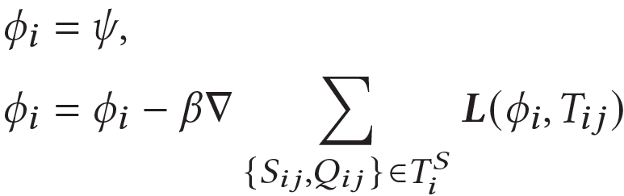
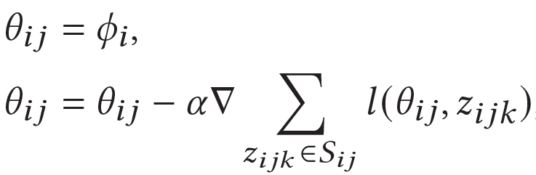
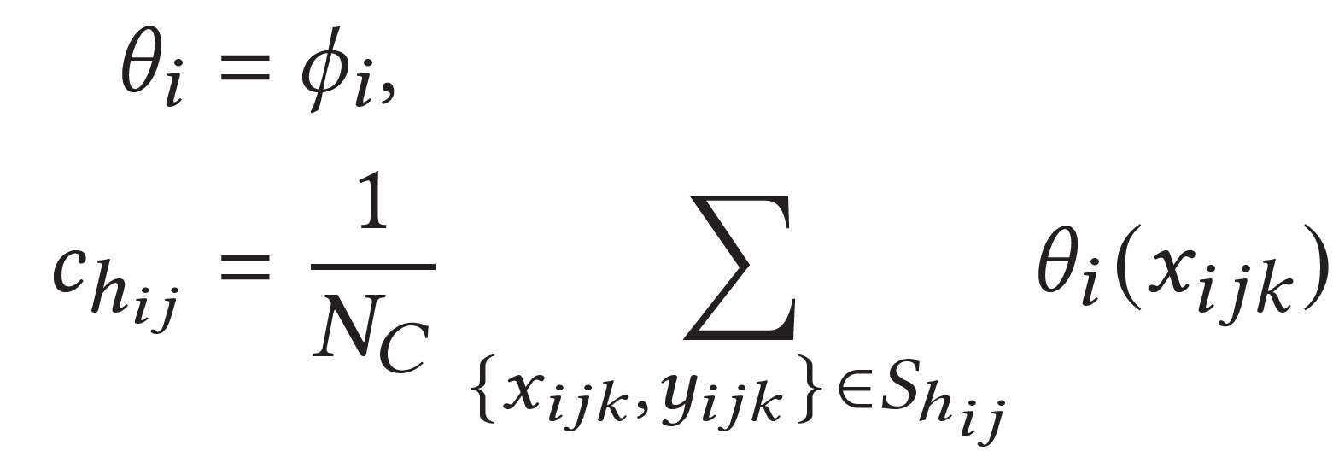
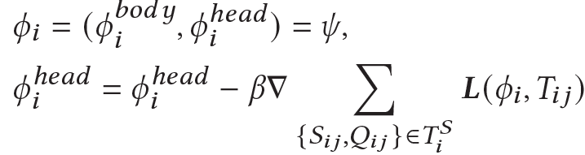
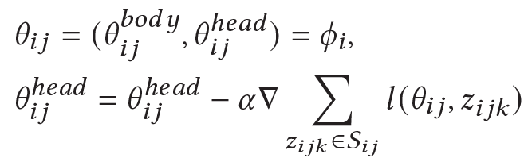

Method(Implementation)
Implement $ψ\left(T_{i}^{S}\right)(S_{ij})$by MAML, ProtoNet and ANIL.
First adaption Second adaption
H-MAML
H-ProtoNet
H-ANIL
Notes:
We implement three different hierarchical meta-learning with MAML, ProtoNet and ANIL.
The details are shown in the paper and will not be repeated here.

Slide 12
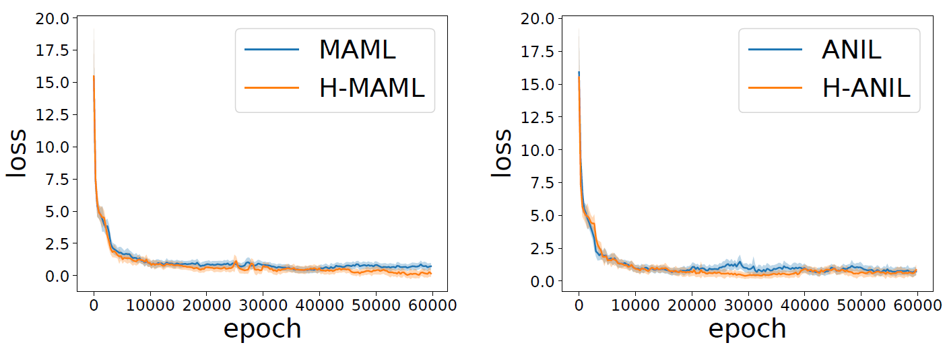
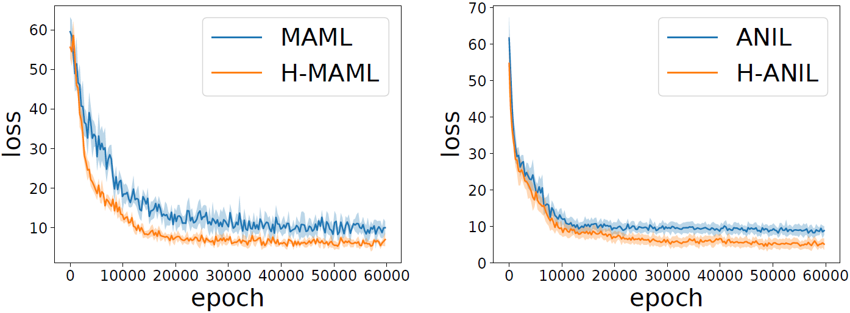
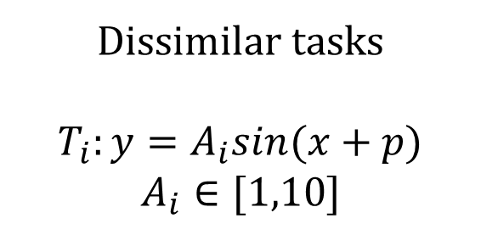
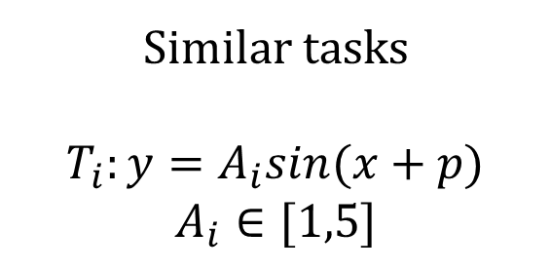
Result
Sine regression
Similar tasks
$$T_{i}:y=A_{i}sin(x+p)$$
$$A_{i}∈[1,5]$$
Dissimilar tasks
$$T_{i}:y=A_{i}sin(x+p)$$
$$A_{i}∈[1,10]$$
Notes:
Now, its experiment result.
First, we conduct experiment on sine regression task.
We adjust the similarity of the tasks by controlling the amplitude of the sine curve.
We find that the hierarchical versions of MAML and ANIL are better than original MAML and ANIL when the tasks are less similar, that is they are less I.I.D.

Slide 13
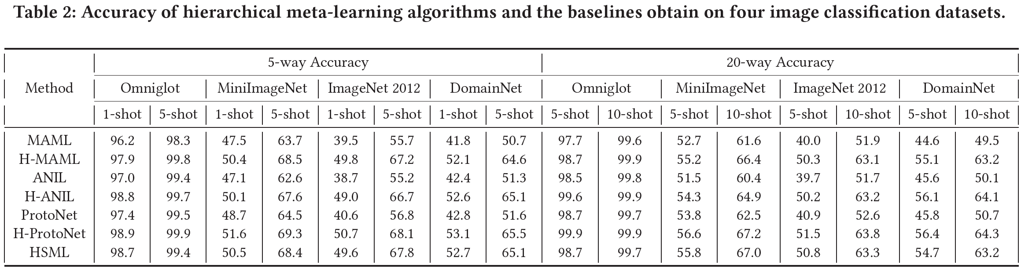
Result
Imagine classification
Notes:
Then，we conduct experiment on four imagine classification datasets. The results show that the Hierarchical meta-learning algorithms are all better than their meta-learning counterparts.

Slide 14
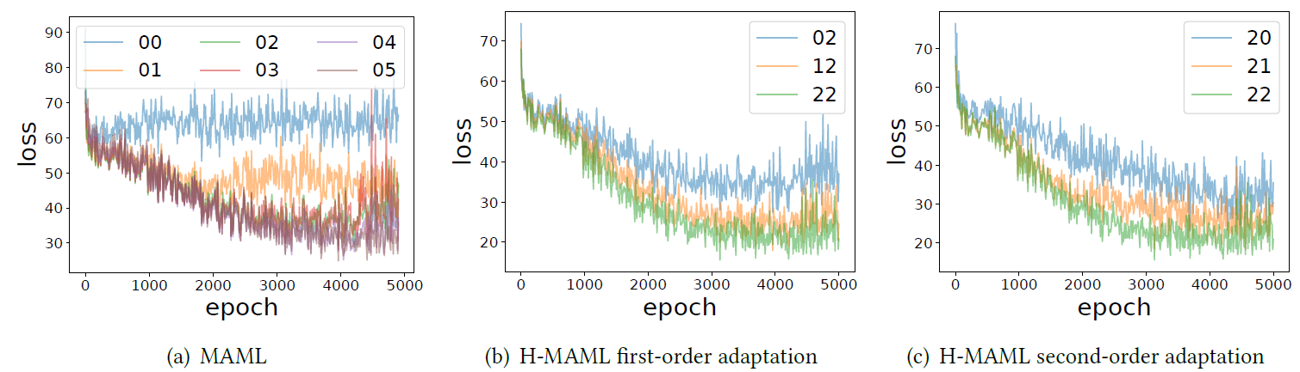
Result
Adaption step & Short horizon
Notes:
In addition, we discussed whether more adaption steps is the source of advantage for hierarchical meta-learning.
This discussion dispelled our doubts about the possible effects of the short horizon phenomenon.

Slide 15
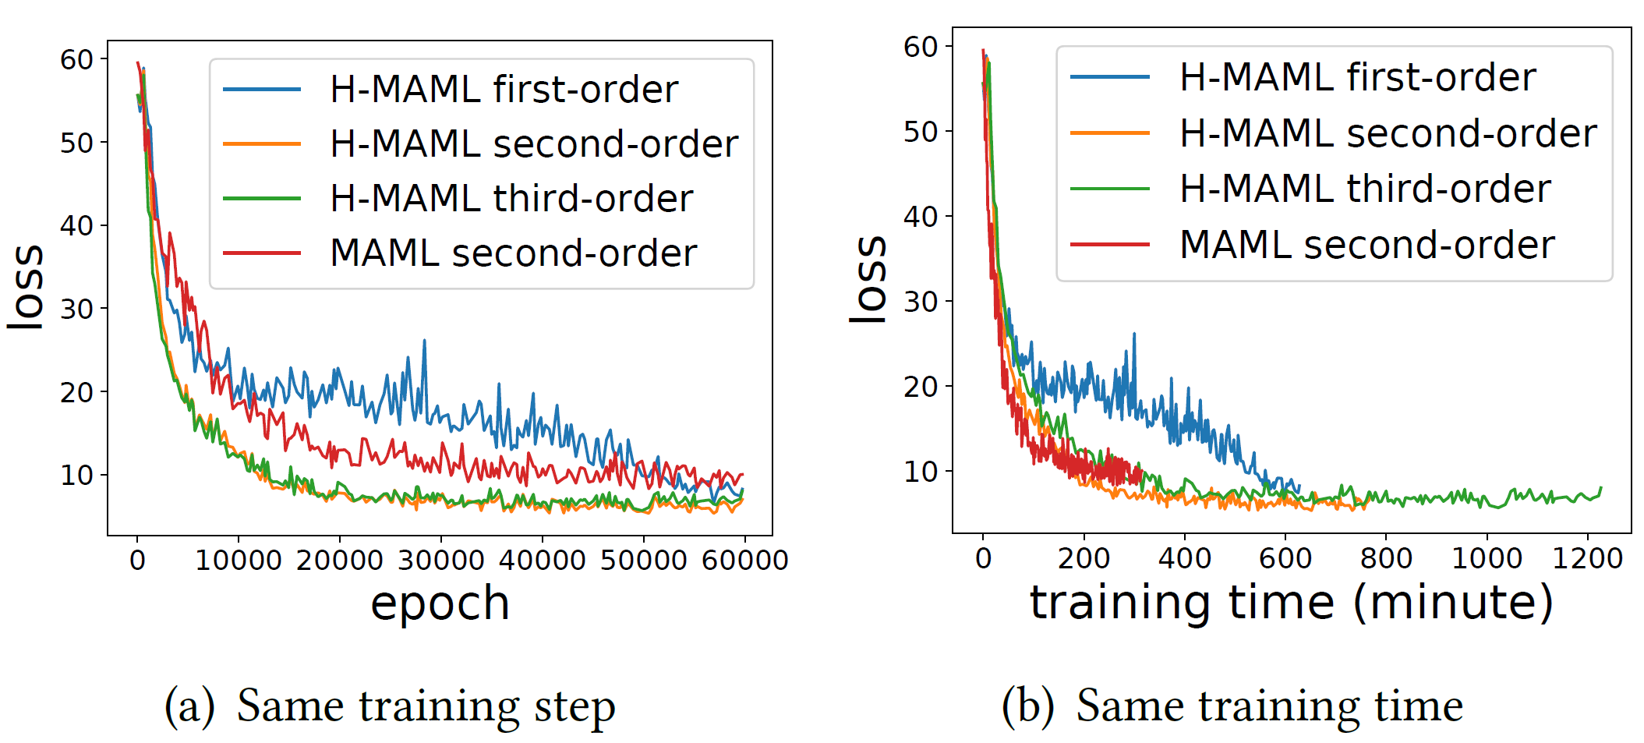
Result
High order derivation & Overhead
Notes:
Finally, we discuss common problems in meta-learning, that is higher order derivation. We find that for hierarchical meta-learning algorithms, the second-order approximation yields optimal performance with the same training overhead.

Slide 16
CONCLUSION
Firstly, it provides a method for constructing hierarchically structured tasks and achieving accurate knowledge extraction for non-i.i.d. tasks using hierarchical meta-learning.
Secondly, leveraging second-order approximation, it yields better few-shot learning performance than the classical meta-learning paradigm, given the same training time constraint.
Lastly, it is a flexible framework that can be equipped with most meta-learning algorithms.
Notes:
In this paper, we propose a new paradigm of hierarchical meta-learning to meta learn the meta-learning algorithm. Our approach offers several benefits.

Slide 17
Thank you
Notes:
That’s all. Thank you for listening.

